Slide 1
Online Recharge System
By:
SANJEEVI V
B.TECH IT

Slide 2
Introduction
The proposed project for recharging mobiles online is a web application developed to automate the mobile recharging process. It can be used by customer of any telecommunication company from anywhere.
The online mobile recharge system is beneficial to both the admin and users. Using the online application, the admin can add new tariff plans and update or modify the existing tariff plans. It helps the users in creating their account, and then recharging the mobiles phones at any time

Slide 3
Objective of the Project
Easy to use
User’s Password encrypted
All cards acceptable
Secured application

Slide 4
Existing System
The existing manual recharge system has many drawbacks; it is time consuming, insecure, and there occurs problems like unavailability of recharge cards, etc.
These drawbacks are creating a trouble in using mobile phones. And, one of solution to these problems is to facilitate online mobile recharge service.

Slide 5
Proposed System
The system doesn’t require any paper and printings to facilitate recharge service.
The customers can recharge their phone by logging on the official website of company from anywhere without any extra charge of recharge.

Slide 6
Modules
Admin
User

Slide 7
Admin Module
Login
View all user details
View mobile (prepaid and postpaid)
View DTH
View Electricity
View Gas
View Water
View subscribers
Updating the application
Logout

Slide 8
User Module
Sign Up
Login
Recharge
Mobile(prepaid /Postpaid)
DTH
Electricity
Gas
Water
History of transaction
Subscribe the site
Logout

Slide 9
Software requirements
Frontend
HTML
CSS
JavaScript
Backend
PHP
Phpmyadmin – mysql
Web Server
XAMPP
Notes:
ddd

Slide 10
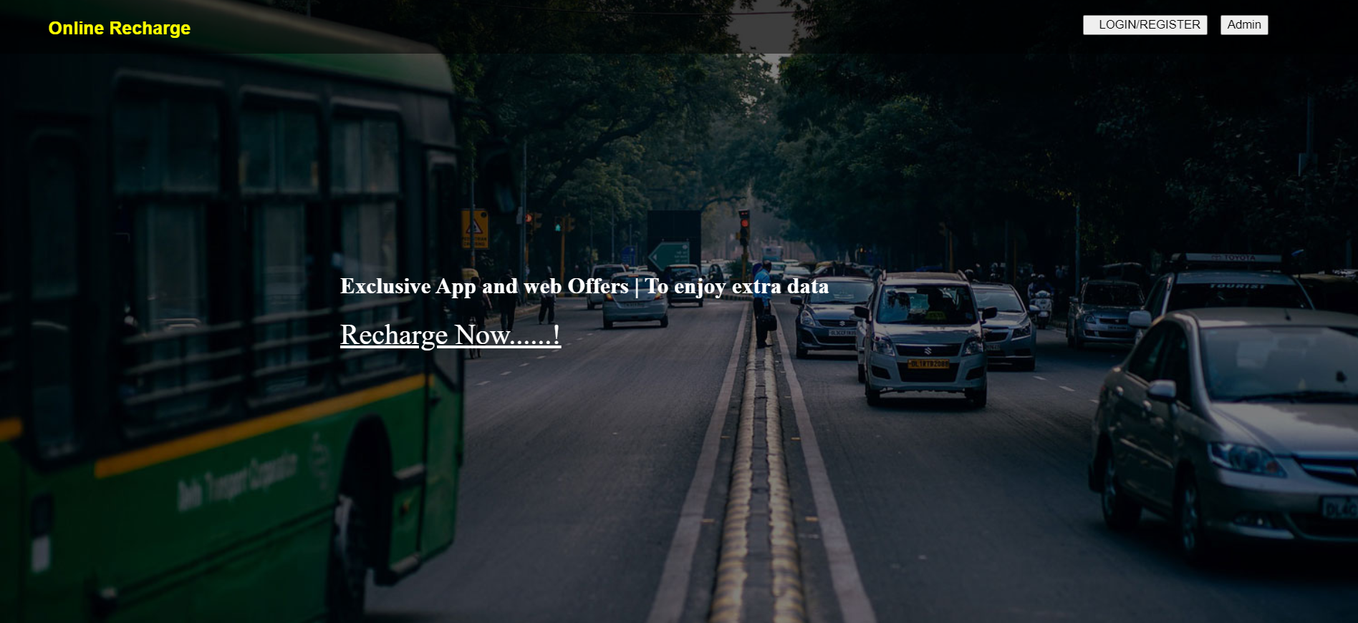

Slide 11
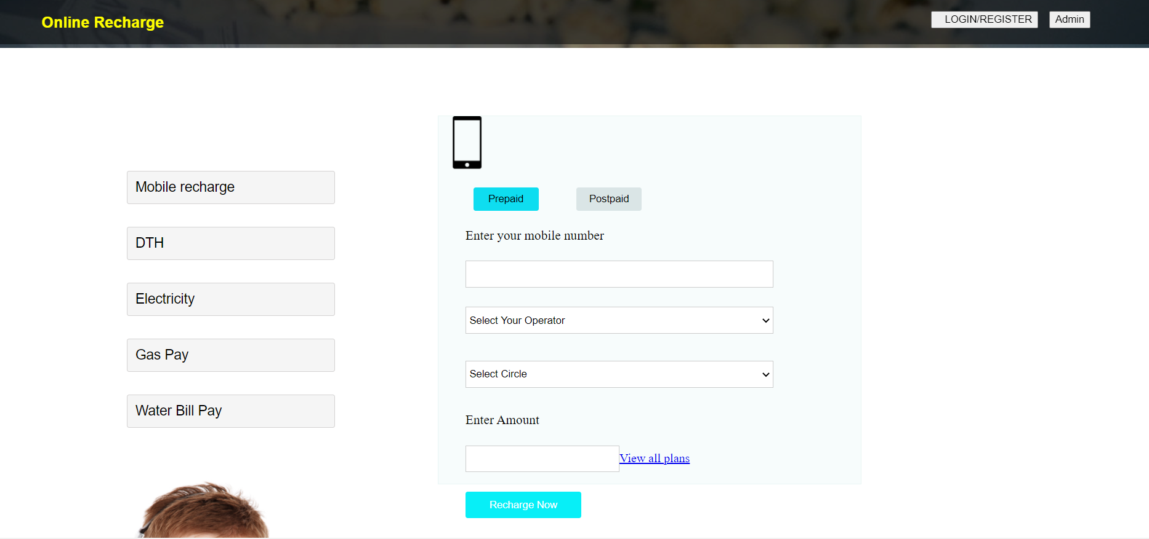
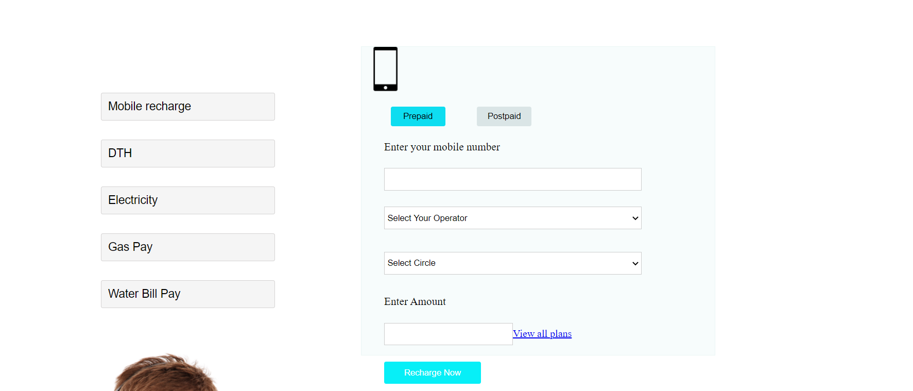

Slide 12
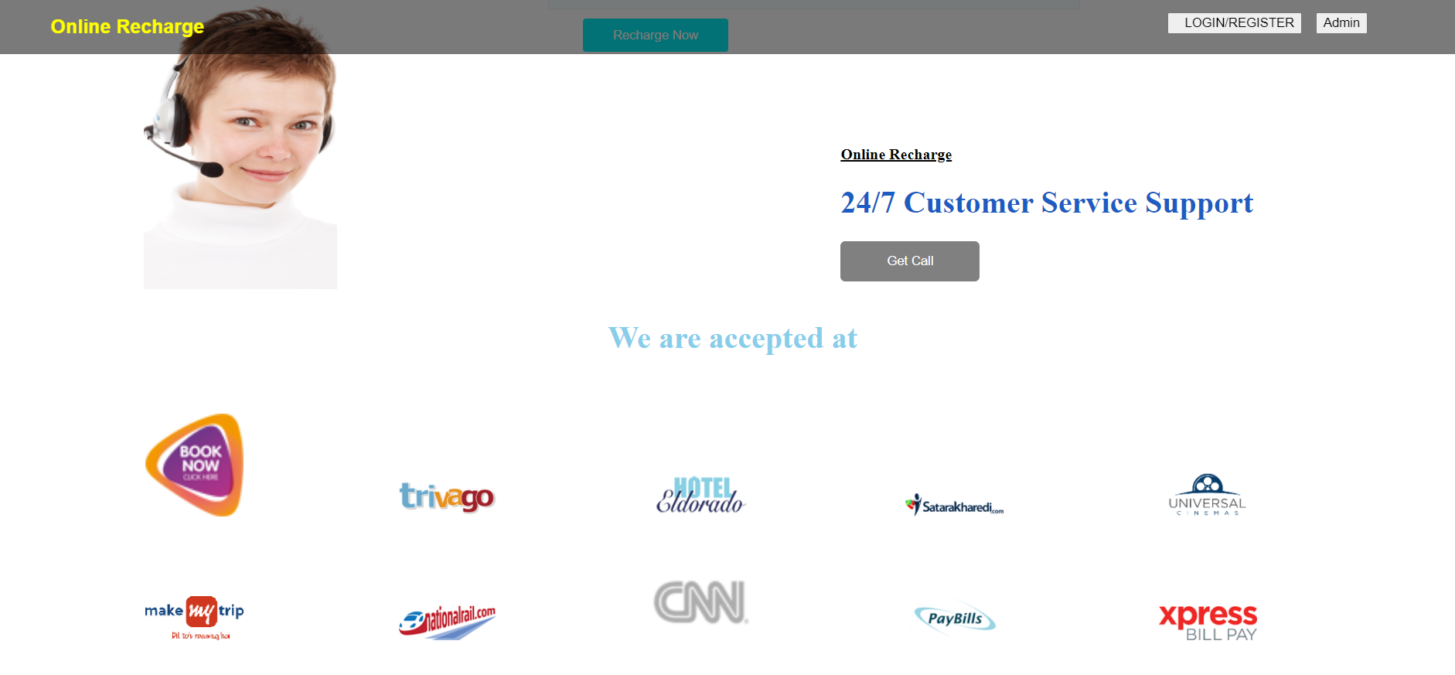

Slide 13
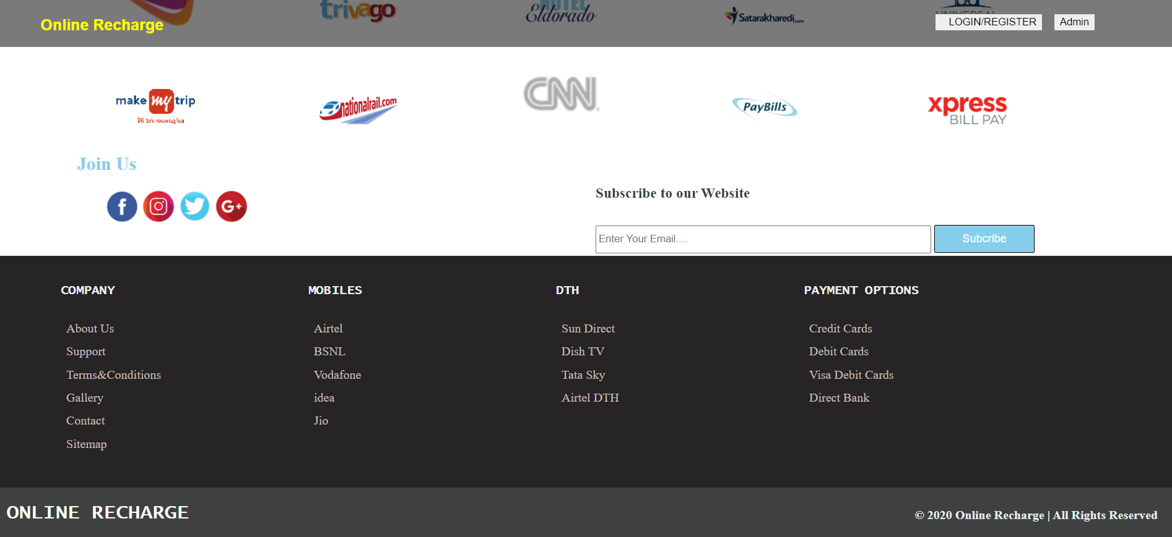

Slide 14
Admin Home

Slide 15
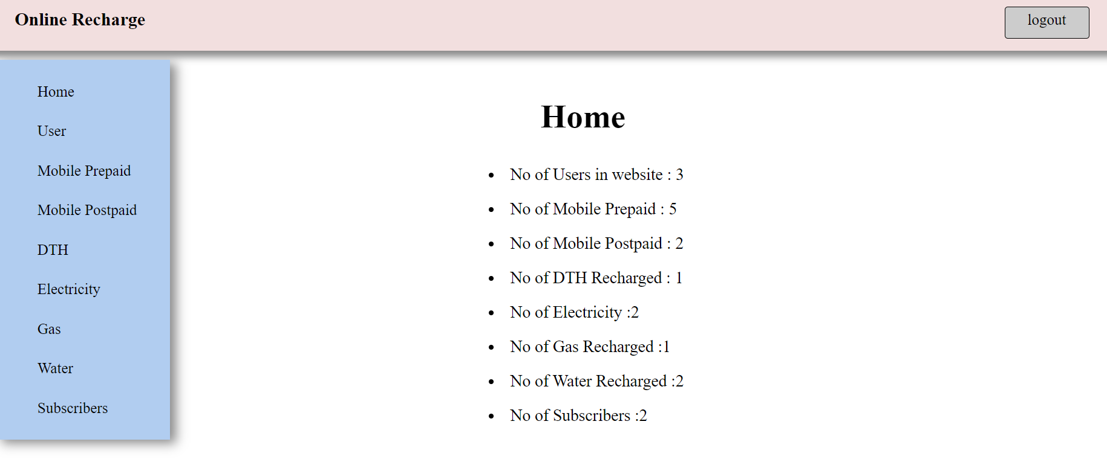

Slide 16
User Home

Slide 17
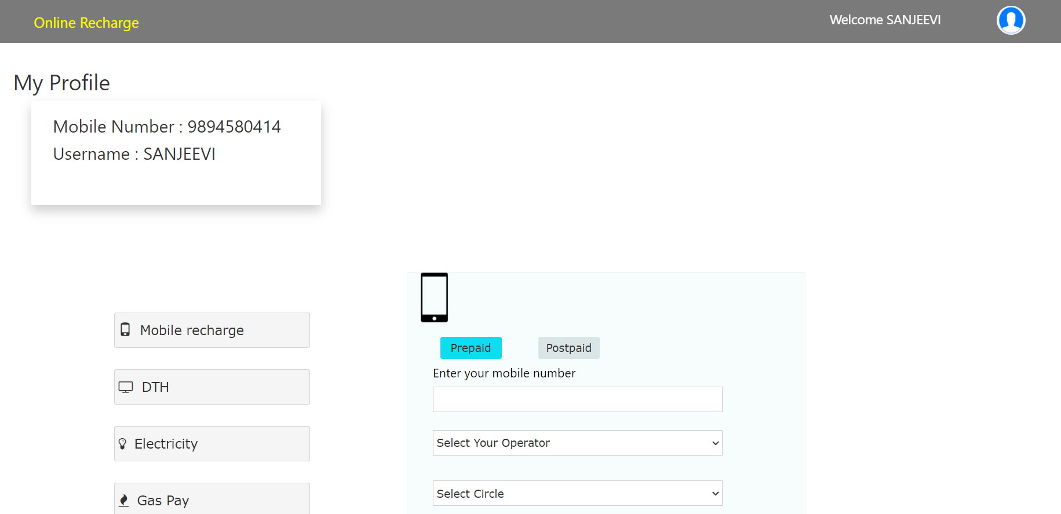

Slide 18
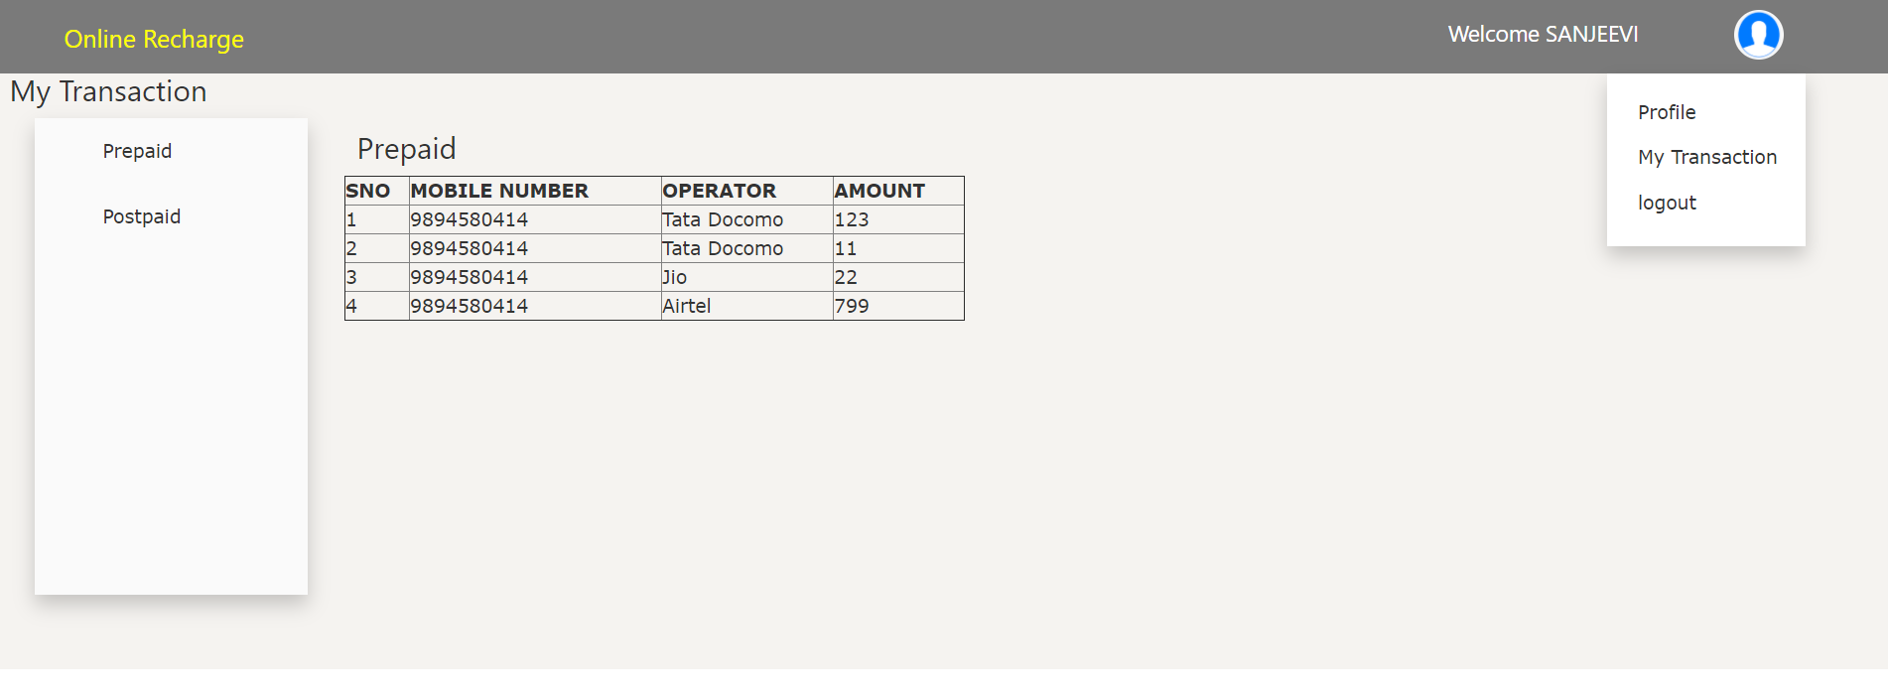

Slide 19
Conclusion
This Online Mobile Recharge system is an internet based application designed with the purpose of facilitating easy, fast, efficient and reliable mobile recharging service
It can be used from anyplace with internet access at any time.
All kinds of mobiles prepaid and postpaid can be recharged using this proposed system.

Slide 20
Thank you

